Slide 1
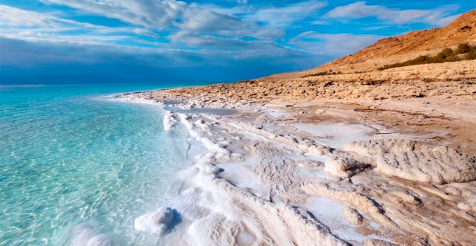
Salinity of Oceans

Slide 2
Origin of Oceans’ Salt
Ocean water contains salts that were carried from rivers or from erupting volcanoes
Terrestrial rocks are full of sodium and chloride ions
Sodium ions were washed out to the sea via erosion and weathering
Source of chloride ions not as clear
Rivers wash dissolved salts into oceans
Build up of over 200 to 300 million years
Evaporation led to increases in salt concentration

Slide 3
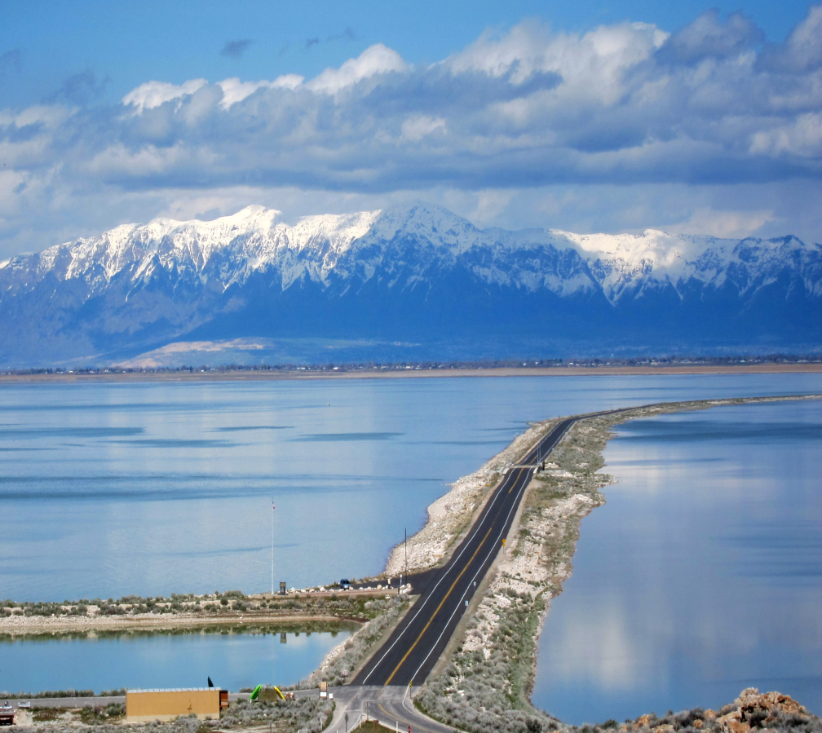
Saltwater Lakes?
Salt water lakes can be up to 10x saltier than oceans
Concentration increases when area decreases
Most lakes have water carried in and out by rivers
Salts that enter the lake will eventually leave
Salt lakes have inflows but no outflows
Salt accumulates in lake

Slide 4
Dead Sea

Slide 5
What is Salinity?
Salinity measures the saltiness or concentration of salt ions in a body of water
Salinity is measured in part per thousand (ppt)
Average salinity of Earth’s ocean is 35 ppt
35 pounds of salt per 1000 pounds of water
Sea water is about 96.5% pure water; 3.5% dissolved solids and gases
85% of dissolved salts are made up of sodium and chloride ions

Slide 6
Effects of Salinity
Dissolved salts can change the chemical, physical, and biological characteristics of oceans
Increase in water density
Less energy need to evaporate sea water
Lower freezing point (salt water needs to be colder than freshwater before it freezes)
Creation of density currents
Alteration of marine plant and animal populations

Slide 8
Geographic Variation of Salinity
The Atlantic Ocean is the saltiest of oceans
Higher salinity at latitudes with higher temperatures
Higher rates of evaporation
20° N and 20° S latitude (35-37 ppt)
Lower salinity at latitudes with higher precipitation
Dilutes the seawater with freshwater
Around the North and South Pole; near the equator
Isolated seas have higher salinity
Mediterranean Sea and Red Sea

Slide 9
Salinity vs. Depth

Slide 10
Salinity vs Depth
At increasing depths, salinity increases
Salinity does not increase at a uniform rate
Layer of water called the halocline where greatest change occurs
Because water is colder at greater depths, salt ions are going to move closer together

Slide 11
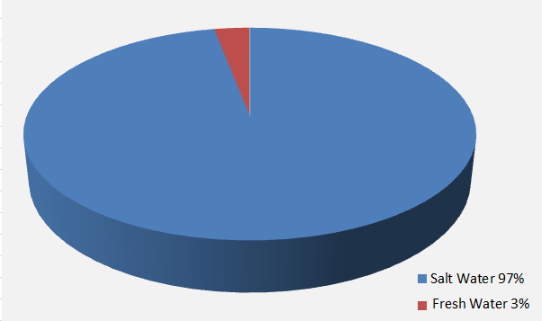
Water Shortages

Slide 12
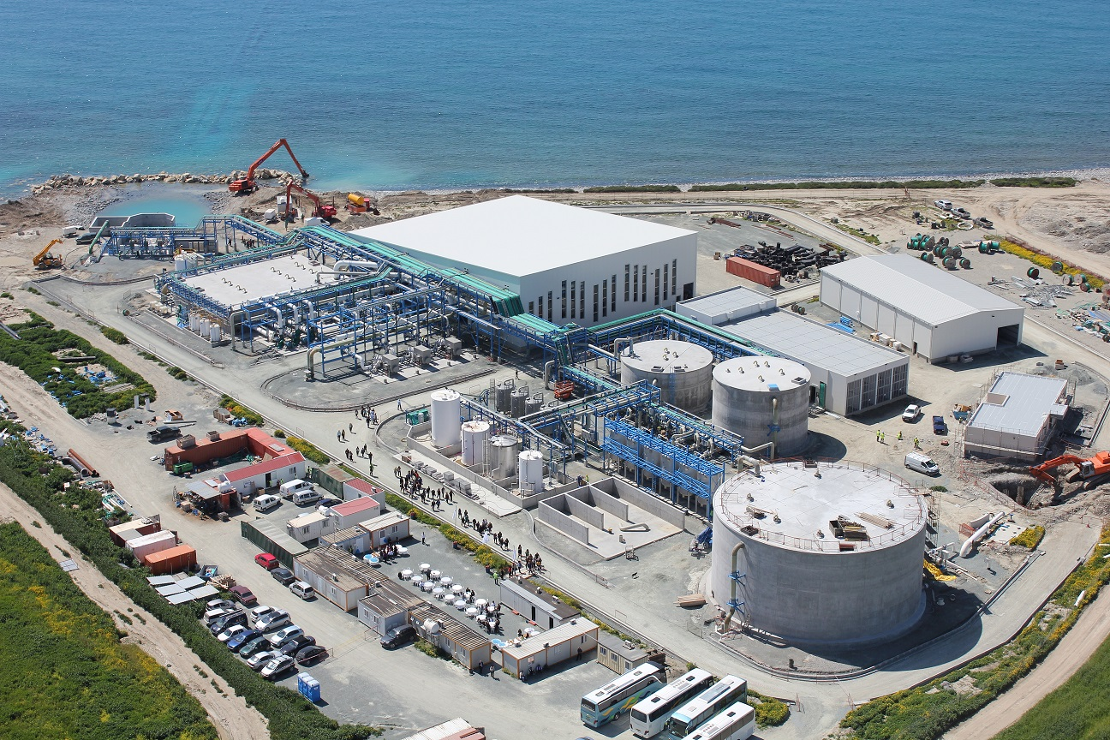
Desalination
Desalination is the process of removing salt from ocean
Removing salt can be done through evaporation and collecting freshwater as a result of condensation
Using glaciers as sources of freshwater
Salt remains under ice when water freezes

