Slide 1
Do Now
Read the article on crazy man-made jellyfish on my desk and answer the questions!
Article Video

Slide 2
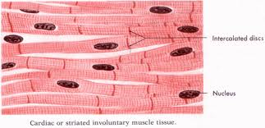
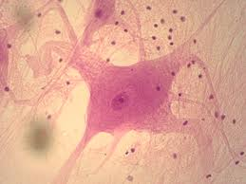
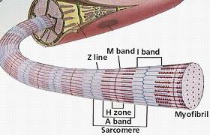
Muscle tissue/Nervous tissue
Section 5.4-5.5

Slide 3
Objectives
To explain the different types of muscle tissue, function and location.
To explain the function and location of nervous tissue.
To identify and explain the 3 types of membranes found in the body.

Slide 4
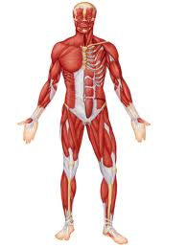
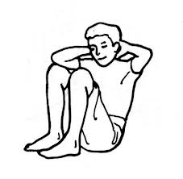
Locations of Muscle Tissue
Associated with the bones of the skeleton, the heart and in the walls of the hollow organs of the body.

Slide 5
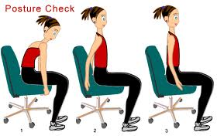
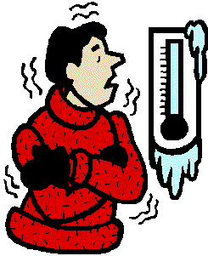
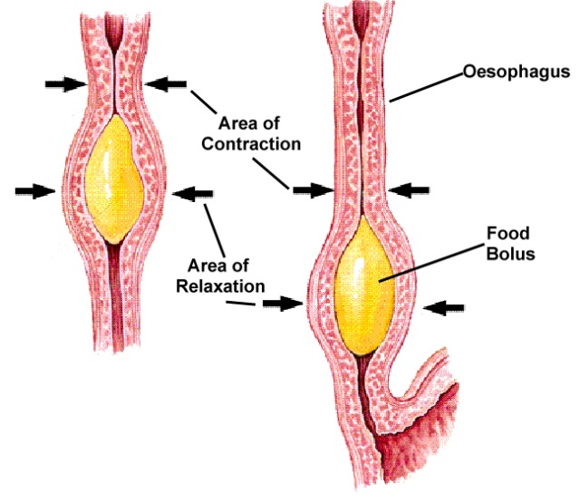
Functions
Movement
Locomotion
Maintains posture
Produces heat
Facial expressions
Pumps blood
Peristalsis

Slide 6
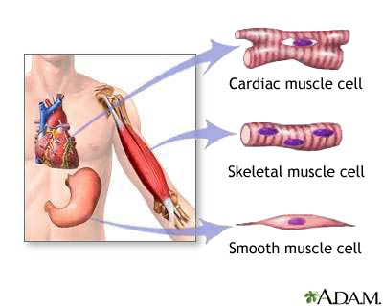
Types of Muscle
1. Skeletal Muscle
2. Cardiac Muscle
3. Smooth Muscle

Slide 7
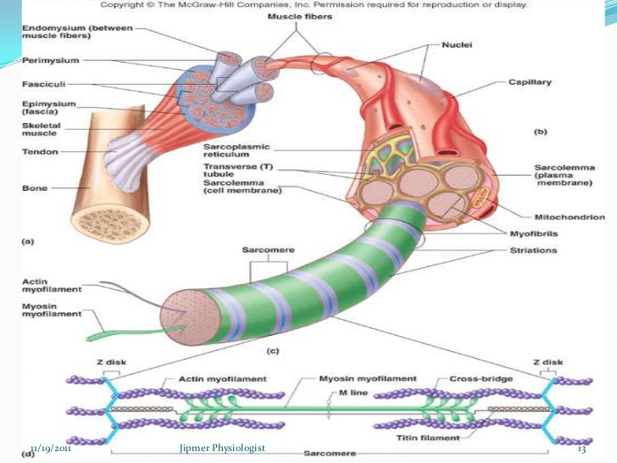
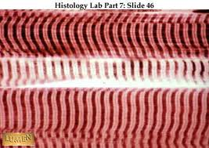
Skeletal Muscle
Locations:
Muscles that attach to bones
Functions:
Controlled by conscious effort- voluntary
Characteristics:
Alternating light and dark strands- striations
Multiple nuclei

Slide 8
Skeletal Muscle

Slide 9
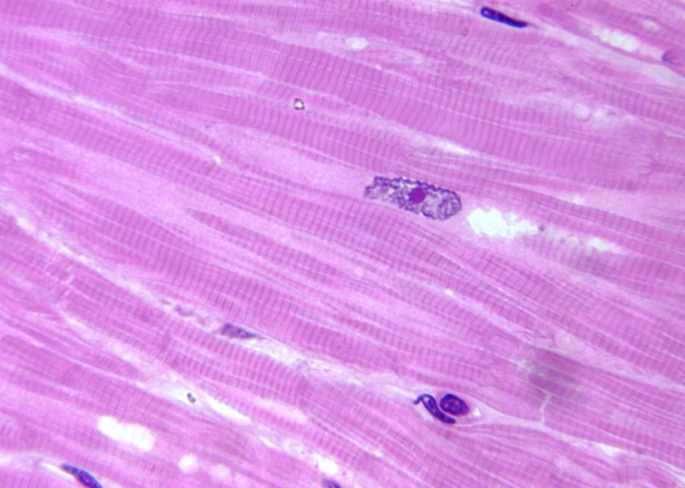
Cardiac Muscle
Locations:
Only in the heart
Functions:
Controlled by unconscious effort- involuntary
Characteristics:
Striated, branched cells
Single nucleus
Cell joined end to end- intercalated disc
Gap junctions – allow ions to pass freely from cell to cell

Slide 10
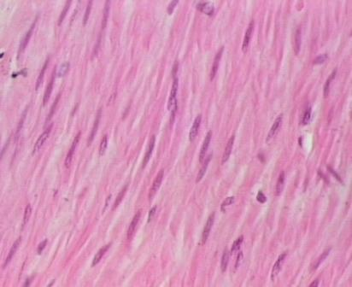
Smooth Muscle
Locations:
Wall of hollow internal organs- stomach, intestine, bladder, uterus, blood vessels etc.
Functions:
Controlled by unconscious effort- involuntary
Characteristics:
Shorter, spindle-shaped
Single nucleus

Slide 11
Nervous Tissue
Location:
Main component of the nervous system,
ie., brain, spinal cord & nerves.
Functions:
Regulates & controls body functions
Generates & transmits nerve impulses
Supports, insulates and protects impulse generating neurons.

Slide 12
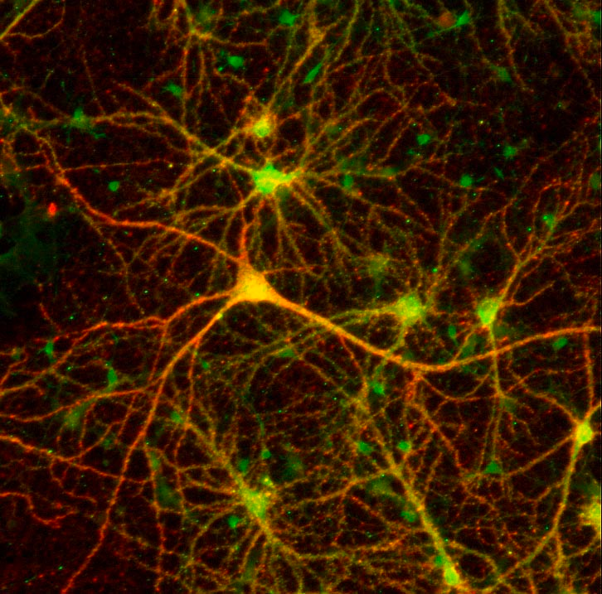
Nervous Tissue
Basic cells- neurons
Sense changes through dendrites
Transmit impulses via axon to other neurons, glands, or muscles, coordinate and regulate
Neuroglial cells
Support and bind
Phagocytosis
Supply nutrients

Slide 13
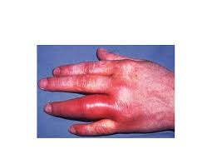
Tissue Repair
When tissues become damaged, inflammatory and immune responses occur (homeostasis)
Inflammation – prevent further injury
Release of chemicals, proteins clot blood
Immune – mounts an attack against an invader

Slide 14
Inflammation

Slide 15
Tissue Repair
There are two major ways tissues get repaired:
1. Regeneration: replacement of tissue w/same kind of cell
2. Fibrosis: repair by dense connective tissue (scar tissue)
Series of events:
1. inflammation of tissue
2. granulation tissue forms (new capillaries)
3. regeneration and fibrosis

Slide 16
Membranes (5.6)
Serous membranes (remember visceral and parietal?!)
Mucous membranes
Cutaneous membranes
Synovial membranes

Slide 17
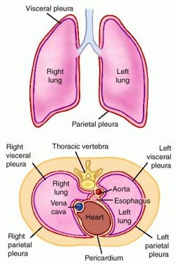
Serous Membranes
Line body cavities that lack opening to inside
Form inner linings (parietal) and cover the organs (visceral)
Simple squamous and loose connective
Cells secrete serous fluid to lubricate membrane surfaces

Slide 18
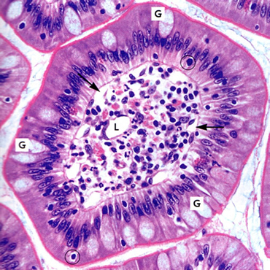
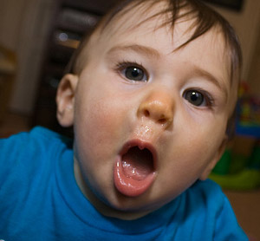
Mucous Membranes
Line cavities and tubes that open to the outside of the body
Ex. oral, nasal cavities, and digestive tract
Epithelium overlying conn. Tissue
Goblet cells secrete mucus

Slide 19
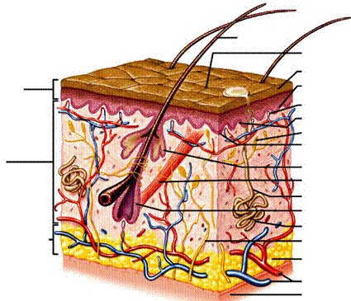
Cutaneous Membranes
Skin!! ☺

Slide 20
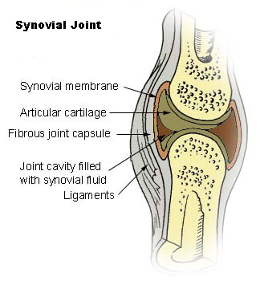
Synovial Membrane
Lines joints!

Slide 21
Review!
Which type of muscle has striations and intercalated discs?
Which type of muscle doesn’t have any striations? Where would you find this type of tissue?
What type of membrane is found lining the digestive tract?
What are the cells called that support neurons found in nervous tissue?
Lab Monday! Chicken wing dissection ☺

