Slide 1
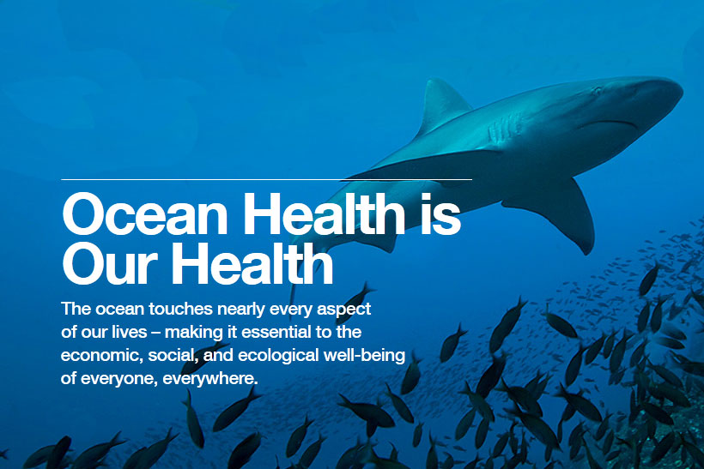
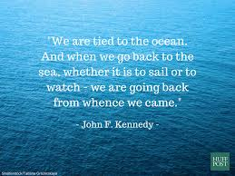
Intro to Oceanography

Slide 2
What is Oceanography?
Oceanography – the study of oceans and seas
Includes a variety of topics such as plate tectonics, ocean currents, and marine organisms
Interdisciplinary science – requires understanding of biology, chemistry, geology, physics, and geography
4 branches of oceanography:
Geological oceanography
Chemical oceanography
Physical oceanography
Marine oceanography

Slide 3
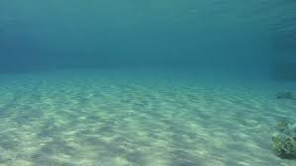
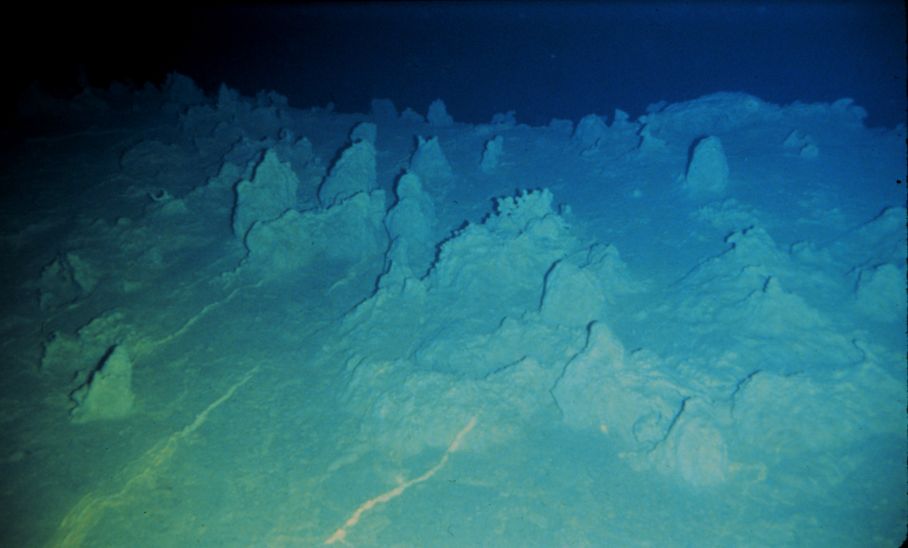
Geological Oceanography
Geological oceanography – study of the shape and the geological features of the ocean floor
Investigations of sea floor spreading and plate tectonics
Sedimentation and fossil formation are important processes in this study

Slide 4
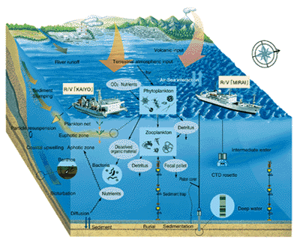
Chemical Oceanography
Chemical oceanography – study of biogeochemical cycles that affect the composition of seawater
Chemical composition of oceans is affected by numerous factors
Think, Pair, Share: Turn to someone near you and talk about what things may impact the chemistry of oceans

Slide 5
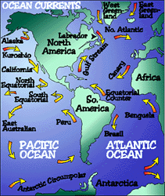
Physical Oceanography
Physical Oceanography – the study of the physical characteristics of oceans and seas
Includes temperature, density, and pressure of seawater
Also discusses wave characteristics and the causes of tides

Slide 6
Marine Oceanography
Marine oceanography – the study of the biological life of oceans and seas
Includes the life cycles and ecological roles of marine plants and animals
Flow of energy through food webs and food chains is also apart of the study

Slide 7
Origin of the World Oceans
Earth is believed to be approximately 4.6 billion years old
Earth was hot and completely dry; combination of meteorites and volcanic activity
After millions of years, Earth cooled allowing rain to fall to the surface
Rain collected in basins on Earth’s crust; 20 million years of rain led to erosion of rocks
Ocean formed 3.5 billion years ago; where first life begins

Slide 8
Ocean Basins
71% of Earth’s surface is covered by water; 97% from oceans
All water on Earth is divided into 4 basins:
Pacific
Atlantic
Indian
Arctic
In 2000, the Southern Ocean became Earth’s fifth ocean
Surrounds Antarctica and extends to 60° S latitude
Some oceanographers do not consider the Southern Ocean to be an official body of water
All of the Earth’s oceans are connected to form the World Ocean

Slide 9
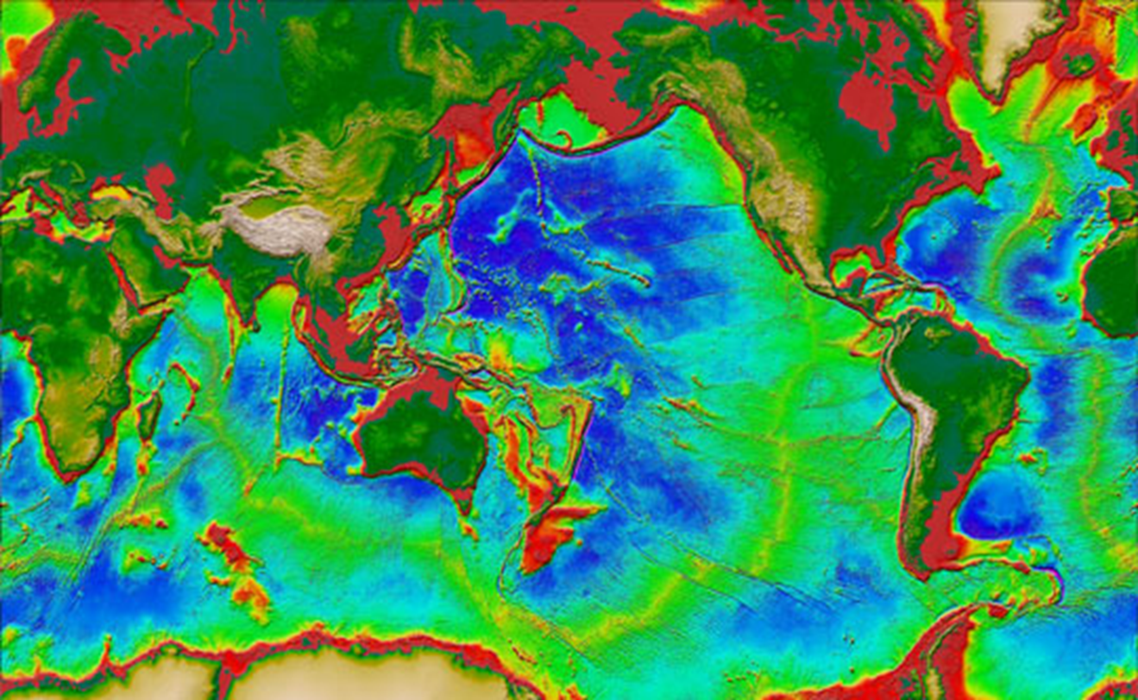
Ocean Basins

