Slide 1
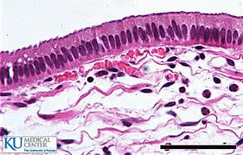
Do Now
Observe the following slide. Identify the type of epithelium present. What else is present in this slide?

Slide 2
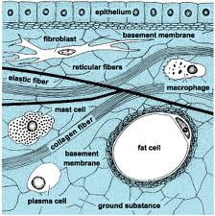
Connective tissue

Slide 3
Objectives
List the different types of connective tissue and where they are located.
Identify the major cells found within connective tissue.
Locate and identify the types of fibers found within connective tissue.

Slide 4
Functions of Connective Tissue
Bind structures
Provide support and protection
Fill spaces
Store fat
Produce blood cells
Protect against infection and help repair tissue damage

Slide 5
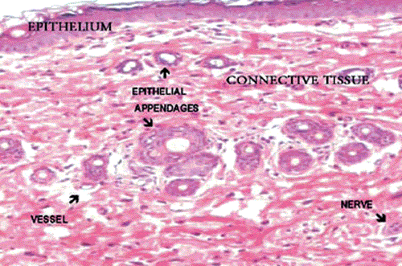
Characteristics of connective tissue
Farther apart than epithelium
Contain an “extracellular matrix” consisting of fibers and ground substance
Vascular

Slide 6
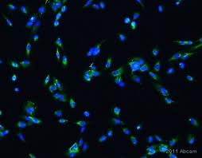
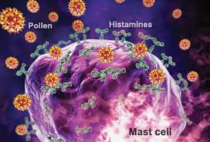
Major cell types
1. Fixed Cells: reside in tissue for extended period of time
  a) Fibroblasts- star shaped, produce fibers by secreting proteins into matrix
  b) Mast Cells- located near blood vessels, release heparin (prevents blood clotting) and histamine (promotes inflammatory responses)

Slide 7
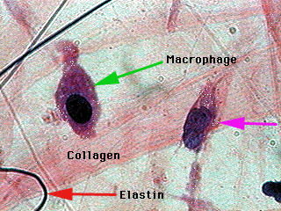
Major cell types
2. Wandering Cells: move through cell and appear in response to injury/infection
a) Macrophages: digests unwanted material within a tissue. (Similar to a lysosome)

Slide 8
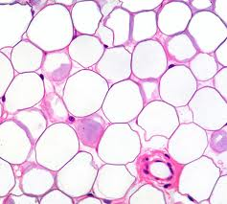
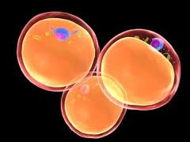
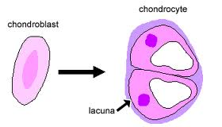
Other Cell Types
Adipocyte: Fat cell
Chondrocyte: cartilage cell
Chondroblast: builds cartilage

Slide 9
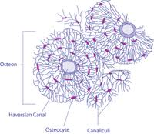
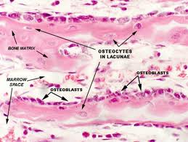
Other Cell Types
Osteoblast: builds bone
Osteoclast: removes bone
Osteocyte: bone cell

Slide 10
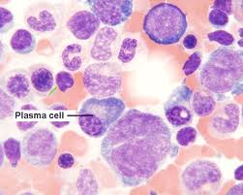
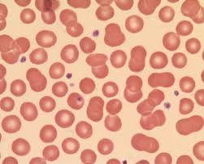
Other Cell Types
Plasma Cell: produces antibodies
Platelet: helps with blood clotting
Red Blood Cell: delivers oxygen to the body

Slide 11
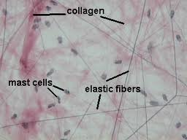
Fibers
Collagenous: made of collagen, thick, strong, make up ligaments and bones
Elastic: made of elastin, thin, frequently stretched, also called “yellow fibers”
Reticular: thin collagenous fibers, highly branched, form support systems.

Slide 12
Do Now
Read the article about the man who regenerated his finger using ECM from a pig bladder!!
Answer the questions on the back of the article.

Slide 13
Jigsaw
* You will be split up into groups. Each group will be responsible for 1-2 types of connective tissue. You will become an expert on this tissue. Ms. B. will then put you into larger groups where you will share your expertise with other classmates!

Slide 14
Do Now
WITHOUT looking at your notes… try to remember the following…
Name 2 main functions of connective tissue.
List 2 cells and 2 fibers you might find in CT.
List 3 examples of CT

Slide 15
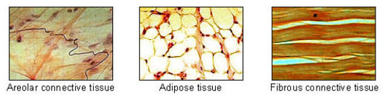
Connective Tissue Proper
1. Loose CT (Areolar)
2. Dense CT
a. Regular
B. Irregular
2. Adipose CT (Fat)
3. Elastic
4. Reticular

Slide 16
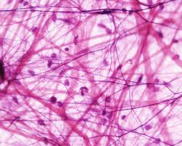
Areolar (“Loose Connective”)
Functions:
Binds organs
Fills spaces between muscles
Location:
Beneath skin/epithelium
Between muscles

Slide 17
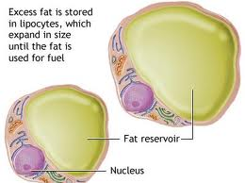
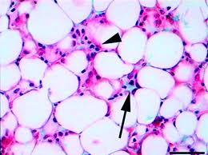
Adipose Tissue
Functions:
Protection
Insulation
Storage for energy
Locations:
1. Beneath skin
2. Around kidneys
3. Behind eyeballs
4. Surface of heart

Slide 18
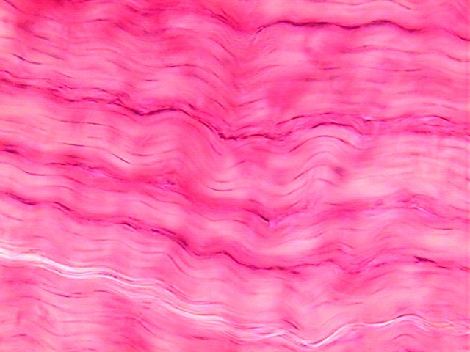
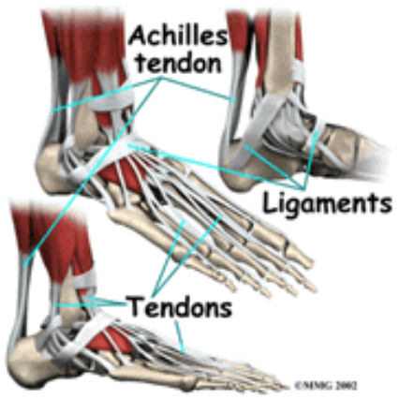
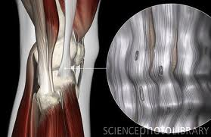
Dense Regular Tissue
Functions:
1. Binds organs together
Locations:
Tendons
Ligaments
Deep dermis

Slide 19
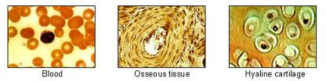
Specialized Connective Tissue
1. Cartilage
2. Bone
3. Blood

Slide 20
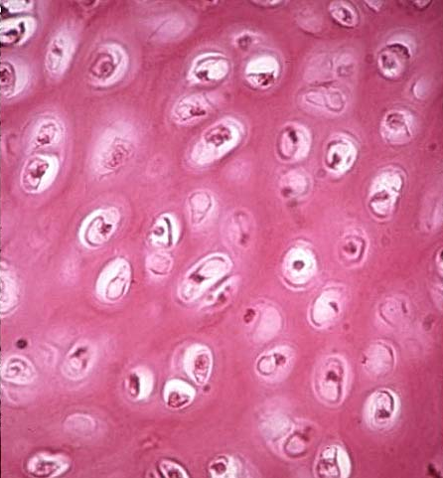
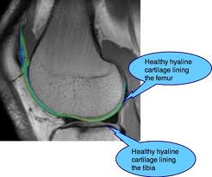
Hyaline Cartilage
Function:
Support
Protection
Framework
Locations:
Nose
Ends of bones
Rings in respiratory passages (ex: trachea)

Slide 21
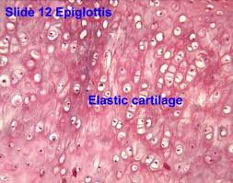
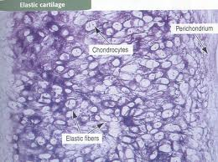
Elastic Cartilage
Functions:
Support
Protection
Framework
Location:
External ear
Parts of Larynx

Slide 22
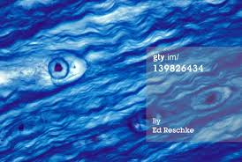
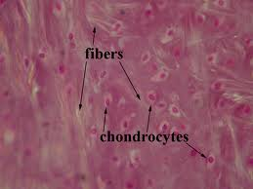
Fibrocartilage
Functions:
Support
Protection
*Absorbs shock
Locations:
Between vertebrae (spine)
Parts of pelvis
Menisci of knees

Slide 23
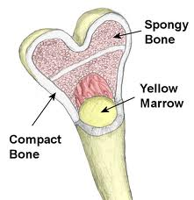
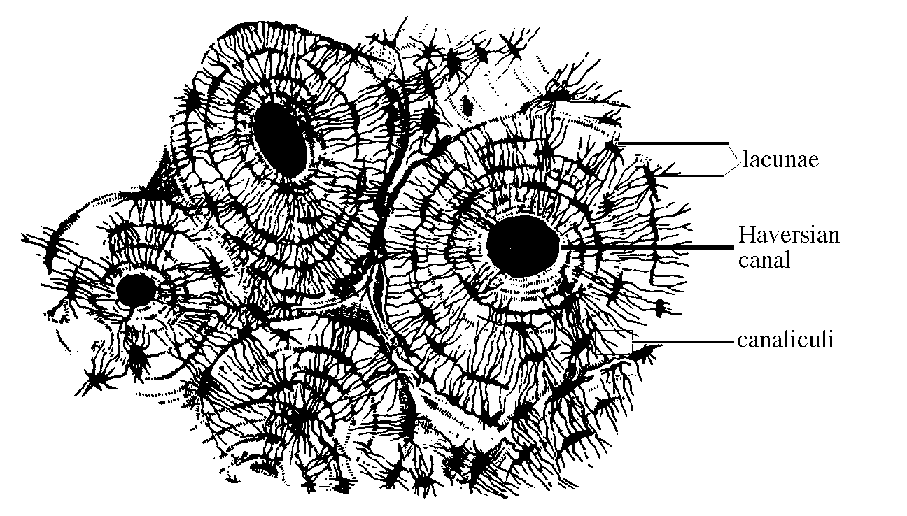
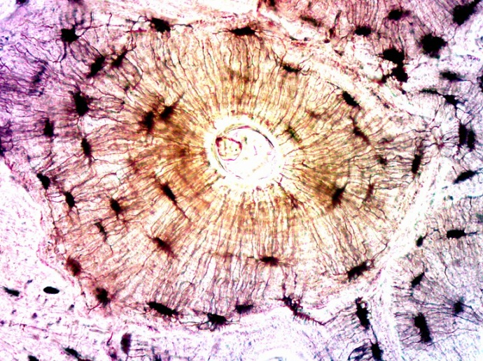
Bone
Functions:
Support
Protection
Framework
Location:
1. Bones of the skeleton

Slide 24
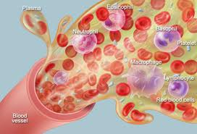
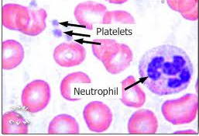
Blood
Functions:
Transport substances
Maintains homeostasis
Locations:
1. Within blood vessels and heart chambers

Slide 25
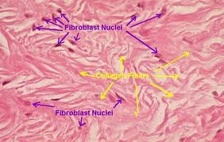
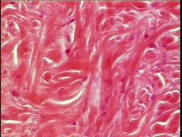
Dense Irregular Tissue
Functions:
1. Protection
Locations:
Deep dermis
Submucosa of intestinal tract (layer beneath lining)

Slide 26
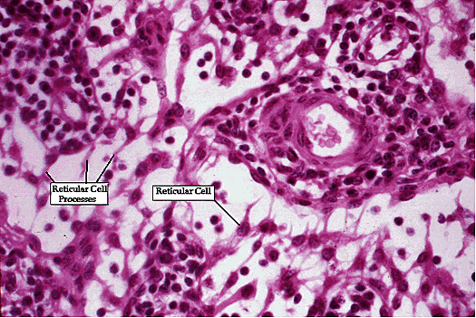
Reticular Tissue
Functions:
Support
*Framework
Locations:
Liver
Kidney
Spleen
Lymph Nodes
Bone Marrow

Slide 27
Elastic Tissue
Functions:
1. *Allows recoil
Locations:
Blood Vessels
Some ligaments and tendons

